Slide 1

Women’s Health Initiative Proteome-Wide Association Study
(WHI PWAS)
Feb 18, 2022
Notes:
I will introduce the research I have done so far, named Women’s Health Initiative Proteome-Wide Association Study, WHI PWAS for short.

Slide 2
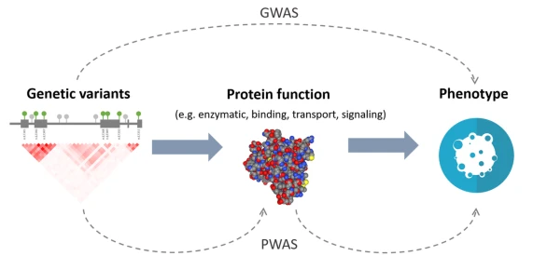

PWAS (Proteome-Wide Association Study)
Protein Level
Notes:
What is PWAS?
•New method for detecting gene-phenotype associations mediated by protein abundance level.
•PWAS aggregates the signal of variants jointly affecting a protein-coding gene and assesses their overall impact on the protein abundance level
•In traditional GWAS, we directly associate genetic variants with phenotype, and then find markers with statistical significance.
•In PWAS, there is an intermediate step, we predict protein level based on genetic variants, and then associate this level with phenotypes.
•A comparison with GWAS and other existing methods proves its capacity to recover causal protein-coding genes and highlight new associations.
•Analogous to TWAS, using protein data instead of transcriptomic data.

Slide 3

Women’s Health Initiative (WHI) Proteomic Data
Subjects: 1133 women aged between 65-95 years old (multiple self reported race/ethnicities)
Genotype: TOPMed Whole Genome Sequencing (Freeze 9b, Phase 2, sequencing center: BROAD)
Protein: 552 protein level data
Samples were included only if they had complete data for all covariates and protein data.
In total, 1002 samples were included in the analysis.
Notes:
Next, Women’s Health Initiative is
•Long-term national health study funded by the NHLBI. (National Heart, Lung, and Blood Institute
•Our data came from this second extension study.
•The main areas of research are cardiovascular disease, cancers, and osteoporotic fractures.
There are 1133 women aged b/w 65-95 years old
and there are 7 phenotypes

Slide 4
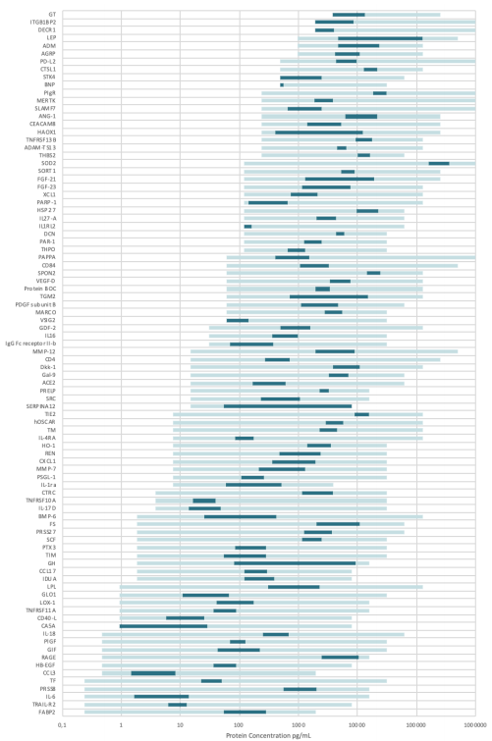
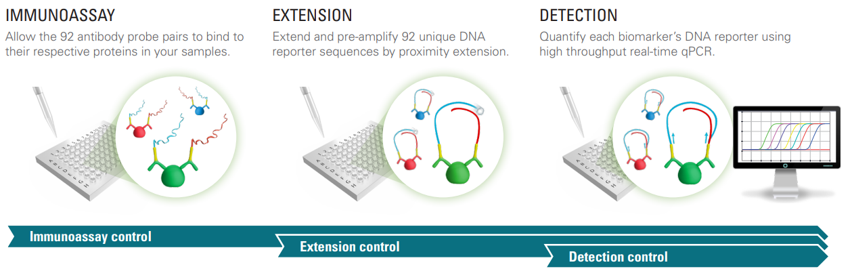
WHI Proteomics Data – Protein (OLINK)
6 panels (Cardiometabolic, Cardiovascular II, Cardiovascular III, Inflammation, Neurology, Onlcology III)
552 proteins total (92 proteins per each panel)
1002 WHI samples distributed over 16 plates (~63 per each)
Notes:
Our data set of course includes proteomics data, produced by Swedish corporation OLINK.
There are 6 panels, named cardiometabolic, cardiovascular 2, 3, etc, and there are 92 proteins per each panel.
So total 552 protein levels are in the data
1288 WHI samples are distributed over 16 plates, so 80 samples per plate on average, and for each plate those 6 panels are applied to obtain protein levels.
Here are some figures regarding how OLINK measures protein levels.
On each panel, 92 oligonucleotide labeled antibody probe pairs are allowed to bind to their respective target protein present in the plate.
And then, they are extended, amplified, subsequently detected, and finally quantified as protein abundance level.

Slide 5
Methods – Proposed method
Step 1
Variant 1 | Variant 2 | … | Variant M
Protein Level
Sample | 1
…
Sample | n/3
Sample | n/3+1
…
Sample | 2n/3
Sample | 2n/3+1
…
Sample | n
Step 2: GWAS
Protein Level ~ Age + Plate + Single Variant
Step 3: Elastic Net Training
Protein Level ~ Significant Variants (pQTLs)
Step 4: Model Testing
Correlation (Observed Protein Level, Predicted Protein Level)
Step 5: Association
Phenotype ~ Predicted Protein Level
(New data, protein data not available)
n X M
n X 1
Notes:
Step2: EPACTS EMMAX test

Slide 6
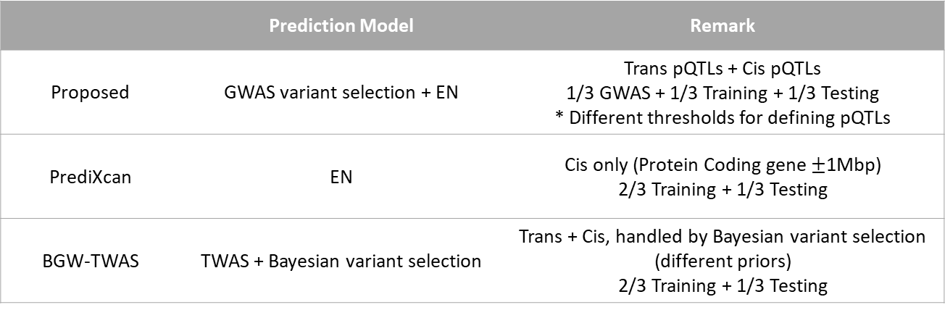
Methods – Other methods for predicting Protein Level
 | Prediction Model | Remark
Proposed | GWAS variant selection + EN | Trans pQTLs + Cis pQTLs 1/3 GWAS + 1/3 Training + 1/3 Testing * Different thresholds for defining pQTLs
PrediXcan | EN | Cis only (Protein Coding gene $±$1Mbp) 2/3 Training + 1/3 Testing
BGW-TWAS | TWAS + Bayesian variant selection | Trans + Cis, handled by Bayesian variant selection (different priors) 2/3 Training + 1/3 Testing
Notes:
Pre-existing TWAS methods focused more on cis variants, while proposed method focused on trans variants also

Slide 7
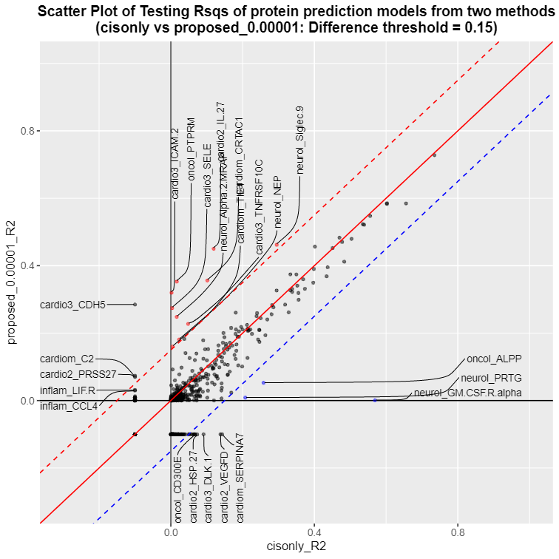
Results – Proposed(pQTL thresh = 1E-4) vs. PrediXcan(cis-only)
Correlation b/w R2 | 0.9365
Proposed > Cis-only | 241
Proposed < Cis-only | 148
Notes:
Most of proteins showed similar prediction R2 for both methods (around red diagonal line)
Some proteins with higher proposed R2 than PrediXcan R2

Slide 8
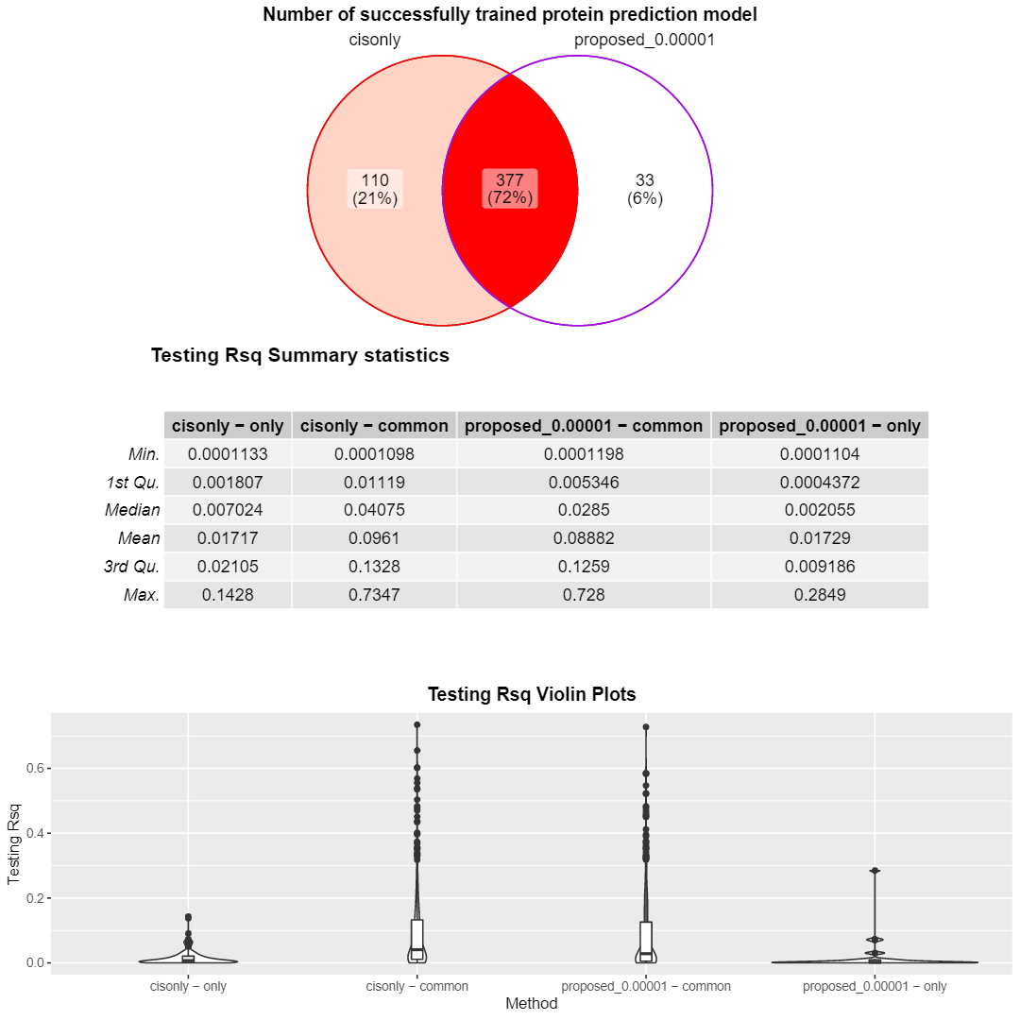
Results – Proposed(pQTL thresh = 1E-4) vs. PrediXcan(cis-only)

Slide 9
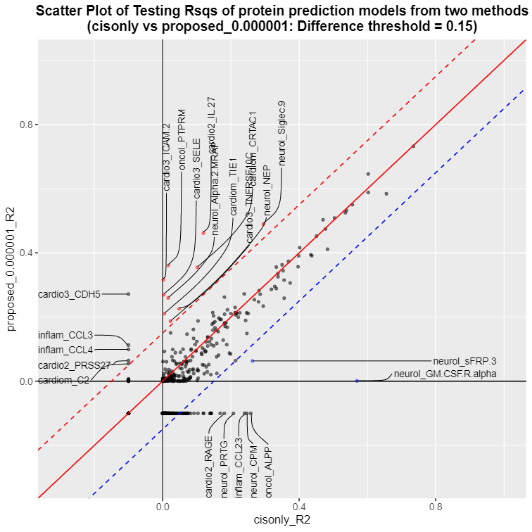
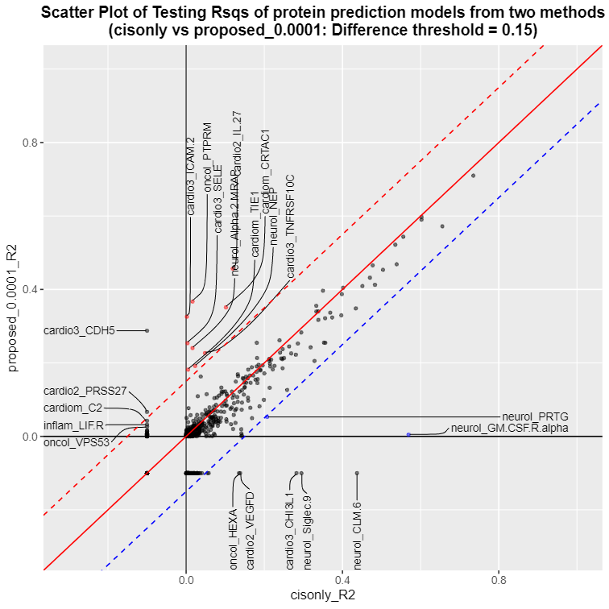
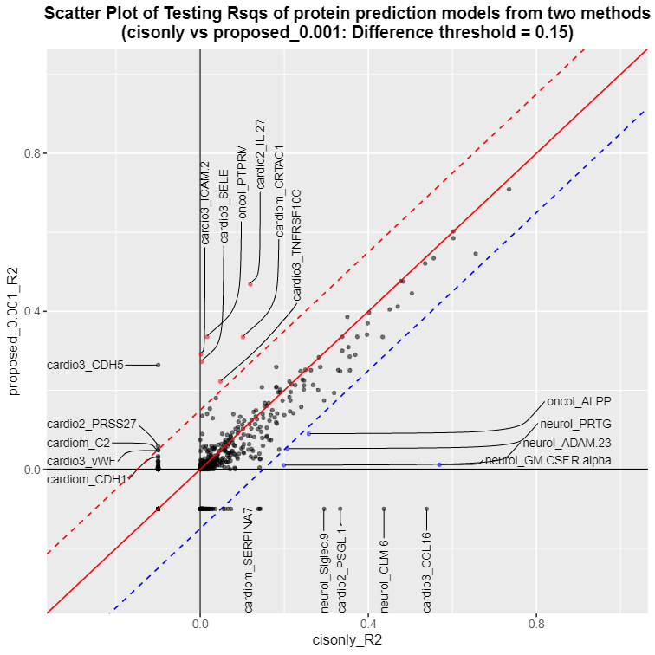
Results – Proposed(other pQTL threshs) vs. PrediXcan(cis-only)
Notes:
Most of proteins showed similar prediction R2 for both methods (around red diagonal line)
Some proteins with higher proposed R2 than PrediXcan R2

Slide 10
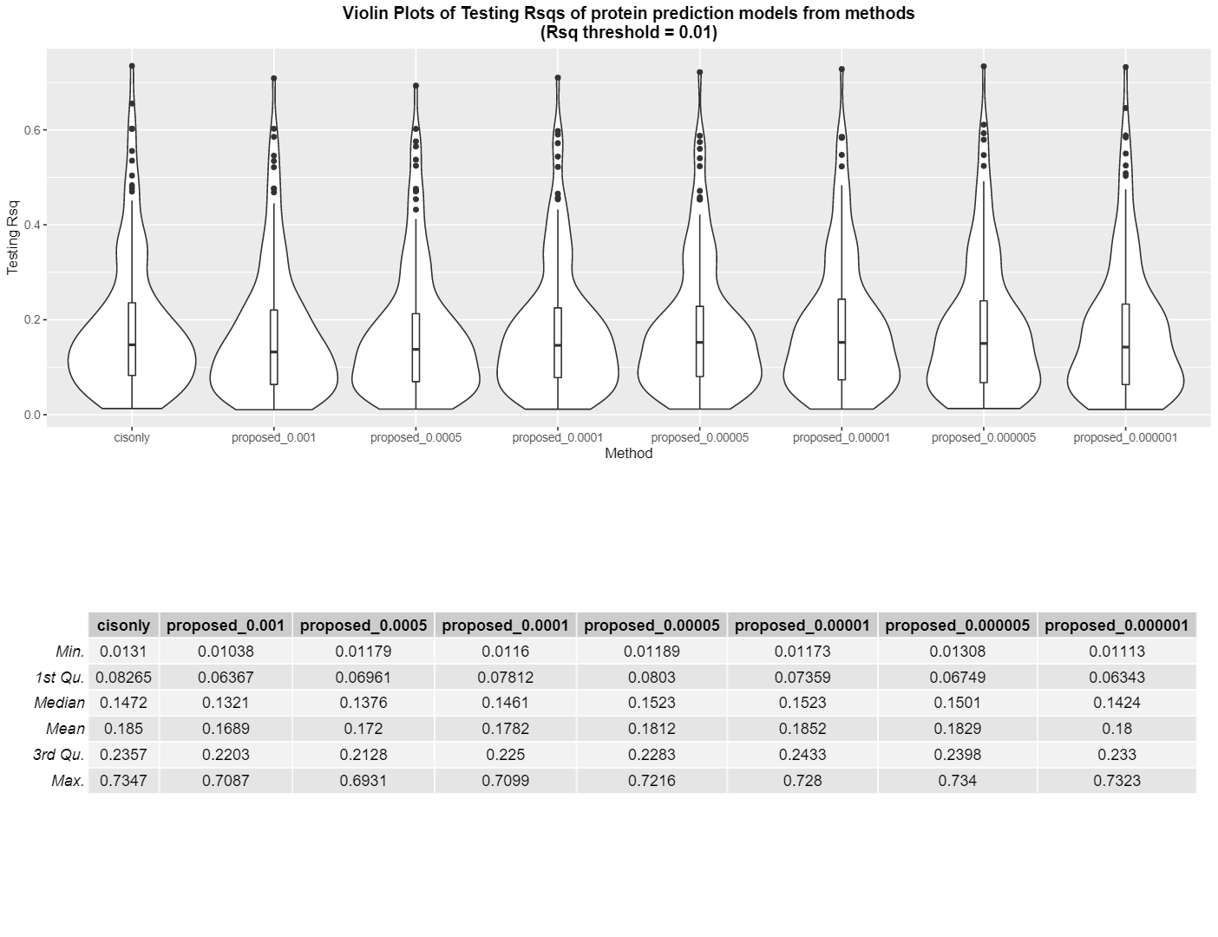
Results – Proposed(other pQTL threshs) vs. PrediXcan(cis-only)
Notes:
Most of proteins showed similar prediction R2 for both methods (around red diagonal line)
Some proteins with higher proposed R2 than PrediXcan R2

Slide 11
Results – Top proteins with higher proposed R2
Protein | Proposed R2† | Cis-only R2 | BGW-TWAS R2 | chr | begin | end
cardio2_IL.27 | 0.456 | 0.119 | 0.108 | 16 | 28499362 | 28512051
cardio3_SELE | 0.253 | 0.003 | 0.010 | 1 | 169722640 | 169764705
cardio3_TNFRSF10C | 0.226 | 0.048 | 0.253 | 8 | 23102921 | 23117445
cardiom_CRTAC1 | 0.351 | 0.101 | 0.165 | 10 | 97865000 | 98030828
neurol_Alpha.2.MRAP | 0.240 | 0.016 | - ‡ | 4 | 3563612 | 3532446
† pQTL threshold of 1E-4 was used
‡ BGW-TWAS method did not converge
Notes:
So we took a look at those proteins, here is the result table.
The prefix is one of the protein panels and the second part is the name of proteins.
We also obtained BGW-TWAS prediction R2, and some interesting points are that for some proteins BGW-TWAS R2 is similar to proposed R2, while it sometimes is very smaller even than prediXcan R2.

Slide 12
Results – Top proteins with higher proposed R2
Protein | Coding region | Top GWAS pQTL | Gene
cardio2_IL.27 | 16:28499362-28512051 | 19:4236999:G:A | EBI3
cardio3_SELE | 1:169722640-169764705 | 9:133273983:A:G | ABO
cardio3_TNFRSF10C | 8:23102921-23117445 | 19:43648948:A:G | PLAUR
cardiom_CRTAC1 | 10:97865000-98030828 | 3:186675758:T:C | HRG, LOC105374258
neurol_Alpha.2.MRAP | 4:3563612-3532446 | 6:31322175:G:A | Non-coding (HLA-B region)*
* tangled with many diseases (Pleiotropic)
Notes:
To see what happened for these proteins, we looked at coding regions and Top GWAS pQTL, protein quantitative trait loci, which showed the smallest p-value during proteome GWAS analysis.
We can see that their pQTLs are not in the coding region, which explains that variants that control protein abundance level the most are not cis-variants, so the prediction using cis-variants only cannot capture these effects, therefore having much smaller prediction quality than our proposed model, which uses both cis and trans variants.

Slide 13
Results – Cardiom_CRTAC1(10:97865000-98030828)
Chr | Position | Dosage allele | Other allele | Effect | Chr | Position | Dosage allele | Other allele | Effect | Chr | Position | Dosage allele | Other allele | Effect
chr1 | 53412053 | G | C | 0.021374624 | chr4 | 8045444 | T | A | 0.029475358 | chr10 | 97882636 | T | G | 0.000909407
chr1 | 55408611 | C | T | 0.013881464 | chr4 | 14102900 | A | G | -0.018981542 | chr10 | 97882974 | C | T | -0.012202091
chr1 | 58736135 | T | C | -0.000498083 | chr4 | 69455575 | A | G | 0.008843145 | chr10 | 97884723 | A | ATAG | 0.042092083
chr1 | 98444139 | G | T | 0.027224516 | chr4 | 69457268 | G | A | 0.009782561 | chr10 | 113971745 | C | T | -0.021123189
chr1 | 175652655 | C | T | 0.008686621 | chr4 | 138038574 | A | G | -0.006400009 | chr11 | 125239338 | G | A | -0.019257107
chr1 | 210187356 | A | C | -0.012936621 | chr4 | 138039670 | A | G | -0.004603097 | chr11 | 130004032 | T | G | 0.063899215
chr1 | 210191636 | T | C | -0.003891127 | chr4 | 138040631 | A | T | -0.01549694 | chr11 | 133939137 | C | T | -0.019393803
chr1 | 210197506 | A | G | -0.011685119 | chr4 | 138061340 | G | A | -0.004893897 | chr12 | 52651219 | G | A | 0.042219022
chr1 | 210198956 | T | C | -0.012431236 | chr4 | 147836315 | A | C | 0.053054811 | chr12 | 52672132 | T | C | 0.037542118
chr1 | 210199110 | T | C | -0.011235327 | chr5 | 2307561 | C | T | 0.018186659 | chr12 | 129728881 | C | A | -0.064542702
chr2 | 45223627 | A | C | -0.091296837 | chr5 | 3679607 | A | G | 0.040055449 | chr12 | 132929135 | C | T | 0.024423865
chr2 | 51391916 | A | G | -0.028901559 | chr5 | 19978017 | C | T | 0.029478138 | chr14 | 24267755 | T | C | -0.031641478
chr2 | 98383912 | A | T | 0.022118694 | chr5 | 57849947 | G | A | -0.035265686 | chr14 | 24267997 | A | T | -0.050932782
chr2 | 98384351 | G | A | 0.017783897 | chr5 | 71702226 | T | C | -0.038315173 | chr14 | 24273475 | C | G | -0.038152002
chr2 | 98384385 | G | C | 0.021066046 | chr5 | 115747837 | C | T | -0.010415121 | chr15 | 58392768 | T | G | -0.001182611
chr2 | 141583289 | C | G | 0.014812876 | chr5 | 158037168 | T | C | 0.000669803 | chr16 | 12826640 | T | C | 0.011353429
chr2 | 183579761 | G | T | -0.030848933 | chr6 | 99030934 | A | G | -0.020057847 | chr16 | 26866855 | C | A | -0.056092685
chr3 | 71785567 | G | C | -0.046403818 | chr7 | 20421953 | C | T | -0.015412669 | chr16 | 28522310 | G | T | 0.052656064
chr3 | 186642021 | T | G | 0.065854479 | chr7 | 26354919 | A | AT | 0.025536226 | chr16 | 52386662 | T | TA | 0.007440686
chr3 | 186642620 | T | G | 0.0250685 | chr8 | 82874999 | A | C | -0.009067646 | chr16 | 88548200 | A | T | 0.007508193
chr3 | 186671770 | T | C | 0.084961575 | chr8 | 82879220 | G | T | -0.001036412 | chr17 | 13724863 | C | T | -0.031508496
chr3 | 186672039 | A | G | 0.023289661 | chr9 | 96693878 | T | C | 0.022032428 | chr17 | 53771447 | G | T | 0.024336922
chr3 | 186675758 | T | C | 0.209109032 | chr10 | 43376514 | T | C | 0.040981711 | chr17 | 55435546 | A | G | 0.022114884
chr3 | 186675997 | G | A | 0.208746359 | chr10 | 60030165 | C | T | -0.068096726 | chr17 | 73949037 | A | G | -0.001669923
chr3 | 186677647 | C | T | 0.165547227 | chr10 | 97865562 | C | T | -0.491256074 | chr18 | 3332475 | C | A | 0.000870523
chr3 | 186678827 | T | C | 0.16290186 | chr10 | 97880706 | C | T | 0.011660173 | chr18 | 57400128 | C | T | -0.005441302
chr4 | 1556563 | A | G | -0.05088851 | chr10 | 97881054 | C | T | 0.07497584 | chr18 | 69192703 | C | G | 0.001089696
 |  |  |  |  |  |  |  |  |  | chrX | 88712818 | C | T | -0.002679584
Chr | Position | Dosage allele | Other allele | Effect
chr10 | 97604412 | T | C | -0.008275998
chr10 | 97605446 | A | C | -0.004166192
chr10 | 97799838 | G | T | -0.031561578
chr10 | 97865562 | C | T | -0.241755278
chr10 | 97874320 | T | A | -0.031657292
chr10 | 97882605 | C | A | -0.001671401
chr10 | 98009631 | T | C | -0.010379587
chr10 | 98597841 | C | T | -0.001523264
Notes:
Here are specific results of prediXcan training and proposed model training, left table is for prediXcan and right is for proposed.
This protein’s coding gene is on the chromosome 10, and we can see that our proposed model successfully includes some cis variants, that are appeared in prediXcan training also, and top pQTLs that are on the chromosome 3.
Since proposed model included trans pQTLs, its prediction R2 was higher than that of prediXcan.

Slide 14
Results – Cardio3_SELE (1:169722640-169764705)
Chr | Position | Dosage allele | Other allele | Effect
chr1 | 168722746 | C | T | 0.015189428
chr1 | 168740549 | C | T | -0.0125724
chr1 | 168744173 | A | G | -0.0017921
chr1 | 168759234 | C | T | 0.021001928
chr1 | 168762414 | G | T | 0.008713327
chr1 | 168765219 | G | A | 0.030086561
chr1 | 169632718 | C | T | -0.065893932
chr1 | 169646042 | C | A | -0.006577659
chr1 | 170224861 | G | A | -0.024104233
chr1 | 170226746 | T | A | -0.03716496
Chr | Position | Dosage allele | Other allele | Effect | Chr | Position | Dosage allele | Other allele | Effect
Chr1 | 118415878 | A | G | -0.042514378 | chr9 | 20125261 | C | T | 0.01589
Chr1 | 182354697 | C | A | -0.00157013 | chr9 | 20125396 | C | T | 0.000869
chr2 | 179643783 | T | G | -0.019339605 | chr9 | 35144751 | G | A | -0.00714
Chr3 | 110310996 | A | G | -0.002775586 | chr9 | 35146875 | G | A | -0.0205
Chr3 | 110311538 | G | A | -0.001705695 | chr9 | 133166937 | T | A | -0.02982
Chr3 | 157140511 | G | A | -0.007264246 | chr9 | 133257761 | T | C | -0.0286
chr3 | 157190525 | G | T | -0.024312382 | chr9 | 133261703 | A | G | 0.00184
chr3 | 157205024 | A | C | -0.024188674 | chr9 | 133263362 | GCGCCCACCACTA | G | -0.27175
chr4 | 12479999 | C | A | -0.036385733 | chr9 | 133266456 | T | C | 0.108349
chr4 | 12511332 | G | C | 0.008626011 | chr9 | 133266790 | C | A | 0.02558
chr4 | 181329067 | A | G | 0.02317239 | chr9 | 133268030 | G | A | 0.014179
chr5 | 11386566 | T | C | 0.032817029 | chr9 | 133271001 | T | C | 0.025298
chr5 | 34928242 | T | G | -0.044098048 | chr9 | 133271018 | T | TAAGAC | 0.121981
chr5 | 34931494 | C | A | -0.068833002 | chr9 | 133271745 | T | C | 0.000713
chr5 | 117887452 | C | G | -0.042829487 | chr9 | 133273813 | C | T | 0.028952
chr5 | 155268614 | T | G | -0.008019795 | chr9 | 133273983 | A | G | 0.128335
chr5 | 155268764 | T | C | -0.001829788 | chr9 | 133274293 | AC | A | -0.03813
chr5 | 162483682 | C | G | 0.018964532 | chr9 | 133274295 | A | T | -0.03873
chr5 | 162485210 | G | A | 0.01702547 | chr9 | 133274414 | A | G | 0.041961
chr5 | 173251980 | T | C | 0.001743214 | chr9 | 133279427 | T | C | 0.081206
chr6 | 166219009 | A | G | 0.017561279 | chr9 | 133317947 | G | A | 0.077365
chr7 | 66172694 | C | T | 0.010034199 | chr9 | 134936064 | G | A | 0.013608
chr8 | 139152871 | T | C | -0.001814465 | chr12 | 7519002 | A | T | 0.021549
chr9 | 10515244 | C | T | -0.034061173 | chr15 | 27576869 | G | T | -0.07486
chr9 | 20111606 | T | C | 0.041389426 | chr16 | 26255328 | T | A | 0.006537
chr9 | 20123970 | C | T | 0.003156217
ABO locus: pQTL for E-selectin
(9:133250401-133276024)
Notes:
The more interesting case is for cardio3_SELE protein that no cis-variants are included in the proposed model training result. Indeed, trans-variants on chr 9 were top pQTLs and those are also in the ABO locus on chr 9, and we found that this locus works as pQTL for E-selectin, so that is the reason why we got these trans-variants as the most power variants controlling protein abundance level.

Slide 15
Discussion
Subset of proteins with trans variants showed higher prediction quality
Future directions: Step 5. Association study of Predicted Protein Level and phenotype on external data without observed protein level
7 phenotypes in the rest of the WHI samples without measured protein:
Coronary Heart Disease (CHD), Congestive Heart Failure (CHF), Myocardial Infarction (MI), Deep Vein Thrombosis (DVT), Hemorrhagic Stroke (STRKHEMO), Ischemic Stroke (STRKISCH), Pulmonary Embolism (PE)
Other TWAS methods (FUSION, TIGAR)
Polygenic risk score approach

Slide 16
References:
Brandes, N., Linial, N. & Linial, M. PWAS: proteome-wide association study—linking genes and phenotypes by functional variation in proteins. Genome Biol 21, 173 (2020).
Jonathan D. Mosley., Mark D. Benson., Robert E. Gerszten., Thomas J. Wang. et al. Probing the Virtual Proteome to Identify Novel Disease Biomarkers. Circulation Vol. 138, No. 22 (2018)
Justin M. Luningham., Junyu Chen., Shizhen Tang., Philip L. De Jager., David A. Bennett., Aron S. Buchman., Jingjing Yang. Bayesian Genome-wide TWAS Method to Leverage both cis- and trans-eQTL Information through Summary Statistics. AJHG Vol. 107, Issue 4, 714-726 (2020)
Gamazon, E., Wheeler, H., Shah, K. et al. A gene-based association method for mapping traits using reference transcriptome data. Nat Genet 47, 1091–1098 (2015).

Slide 17
Supplementary Slides
Notes:
For step 3, EN model training,
we consider additive model of protein …
Similar to PrediXcan approach
Hyper parameters alpha, lambda are tuned based on CV
* different variants for each protein

Slide 18
Methods – Proposed method Details
Step 2: Proteomic GWAS to select nominally significant variants
Protein Level ~ Age + GWAS Array + plate + single variant
Inverse Normalize raw protein level
EPACTS v3.3.0 EMMAX (Efficient Mixed Model Association eXpedited) test accounting for sample structure including population structure and hidden relatedness
Variants with nominal significant p-value < 1E-04 were selected for the next step (pQTL)
Notes:
So here are details.
We perform regression analysis with Protein Level as outcome and Age as continuous covariate, GWAS Array and plate as factor covariate, and single variant, which is a dosage, as a continuous covariate.
Inverse Normalize raw protein level (transform protein level to follow N(0,1) distribution)
All the well-imputed common variants (NOT only cis-variants) are tested
EPACTS v3.3.0 EMMAX (Efficient Mixed Model Association eXpedited) test accounting for sample structure including population structure and hidden relatedness
Variants with nominal significant p-value < 1E-04 were selected for the next step

Slide 19
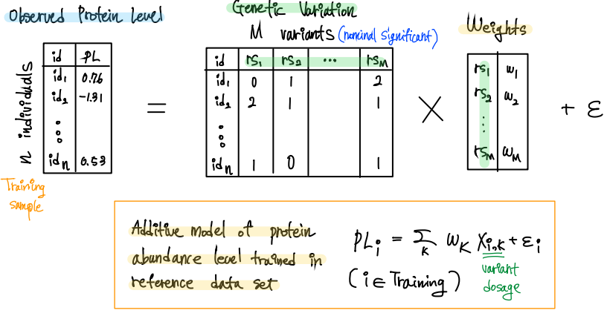
Methods – Proposed method Details
Step 3. EN model training on nominally significant variants
Notes:
For step 3, EN model training,
we consider additive model of protein …
Similar to PrediXcan approach
Hyper parameters alpha, lambda are tuned based on CV
* different variants for each protein

Slide 20
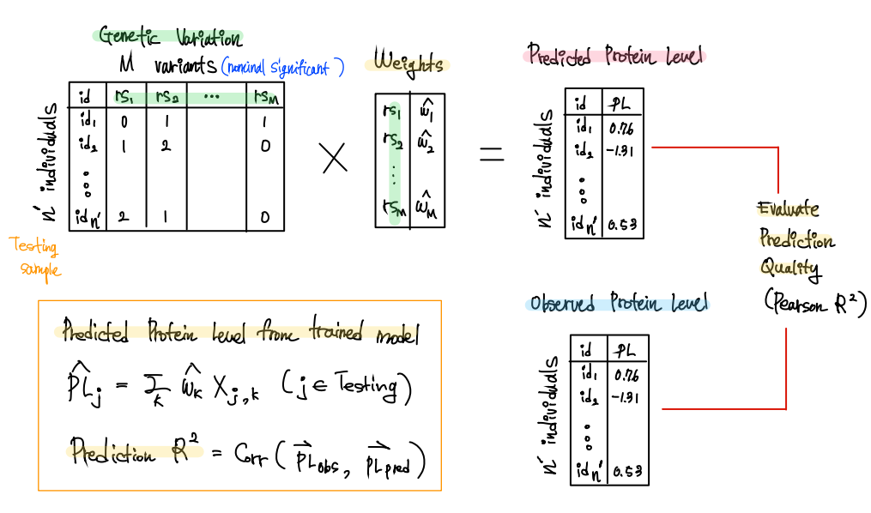
Methods – Proposed method Details
Step 4. Model evaluation on testing samples
Notes:
For step 4, we use pre-trained model to predict protein level on testing samples
As you can see, this framework is really similar to TWAS framework, so we can utilize a variety of TWAS methods to predict protein level instead of gene expression, so we compared some TWAS methods in terms of prediction quality.

Slide 21
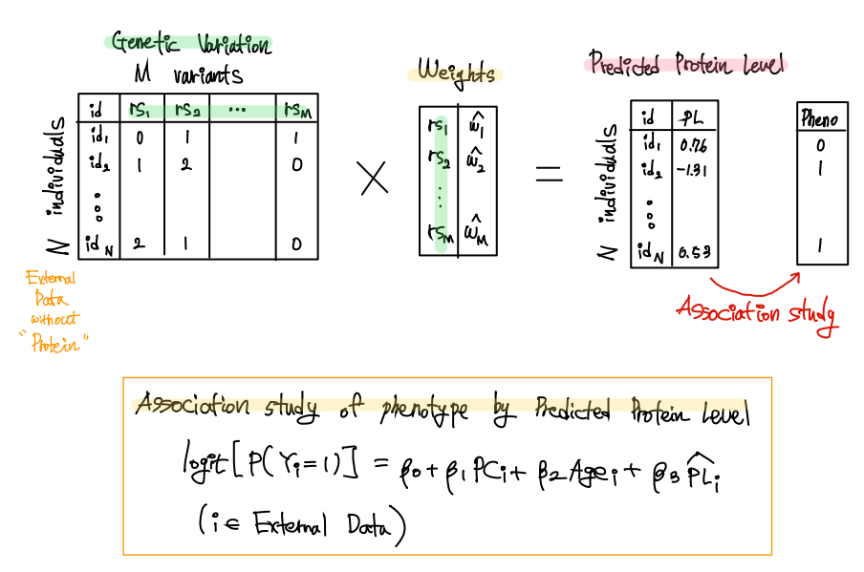
Methods – Proposed method Details
Step 5 (Future). Association study of Predicted Protein Level and phenotype
Notes:
The last step is future step
We need external genotype data set without protein level, and we predict protein levels based on our trained model from step4, and the perform
•Logistic regression of phenotype regressed on predicted protein levels
The model is like this, we include PC, Age, and predicted protein levels.
•Here Only proteins with prediction R2 > 0.05 are used because we do not want spurious association due to poor prediction

